Slide 1


EduBridge Capstone Project
Bank Customer Churn Prediction
Presented By :
Kiran Suresh Phondake

Slide 2
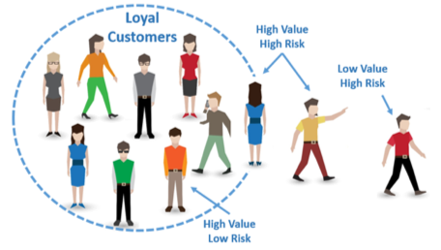
Introduction
Customer churn is a fundamental problem for all the companies and it is defined as the loss of customers because they move out to other competitors.
“ Churn = movement of customer from one company to another ”
There are two types of churns : Voluntary Churns & Involuntary Churns
The Reasons can be :
Availability of latest technology
Customer friendly bank staff
Low interest rates
Location
Services offered

Slide 3
Problem Statement
The problem to be investigated in this study is the analysis of the Bank customer churn history with respect to different features available in dataset.
The main objectives of this project are To develop customer churn predictive model using supervised machine learning classifiers algorithms; To use the model to predict the potential churners and non-churners; To evaluate and compare the performance of the model based on Accuracy.

Slide 4
Tools and Libraries
Jupyter Notebook : Jupyter Notebook is an open free source web application that is used for data cleaning and transformation, numerical, simulation, statistical modelling, data visualization and so on.
SAS : Statistical Analysis Software for advanced analysis, multivariate evaluation, insights into trade, knowledge management & prescient analytics.
Libraries :
1. Pandas 2. NumPy
3. Matplotlib 4. Seaborn
5. Sklearn 6. Tableau

Slide 5
Workflow
Data Collection
Data Cleaning
Analysis of Data
Evaluation of Prediction outcomes
Build Model & train the Model
Choosing the best Model For prediction

Slide 6
Data Collection
The dataset was extracted from the database of one of the bank from Kaggle.
The dataset contained about 10127 customers’ data with 21 attributes.
Features | Description
CLIENTNUM | Unique identification number for customers.
Attrition_Flag | Customer activity, Attrited or existing
Customer_Age | Customer's Age in Years
Gender | Customer's gender, M for Male; F for Female
Dependent_count | Number of dependents
Education_Level | Educational Qualification of the account holder
Marital_Status | Married, Single, Divorced, Unknown

Slide 7
Features | Description
Income_Category | Annual Income Category of the account holder
Card_Category | Type of Card (Blue, Silver, Gold, Platinum)
Months_on_book | Period of relationship with bank
Total_Relationship_Count | Total number of products held by the customer
Months_Inactive_12_mon | Number of months inactive in the last 12 months
Contacts_Count_12_mon | Number of Contacts in the last 12 months
Credit_Limit | Credit Limit on the Credit Card
Total_Revolving_Bal | Total Revolving Balance on the Credit Card
Avg_Open_To_Buy | Open to Buy Credit Line (Average of last 12 months)
Total_Amt_Chng_Q4_Q1 | Change in Transaction Amount (Q4 over Q1)
Total_Trans_Amt | Total Transaction Amount (Last 12 months)
Total_Trans_Ct | Total Transaction Count (Last 12 months)
Total_Ct_Chng_Q4_Q1 | Change in Transaction Count (Q4 over Q1)
Avg_Utilization_Ratio | Average Card Utilization Ratio

Slide 8
Data Cleaning
There are some unknown data in categorical columns, therefore we will replace missing values with the mode values.
To achieve better performance, the categorical data was transformed to numerical format using the get dummies function in Python.
Feature scaling was applied to normalize the data and improved the computational time.

Slide 9
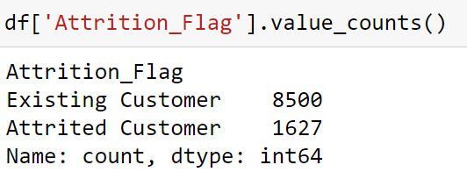
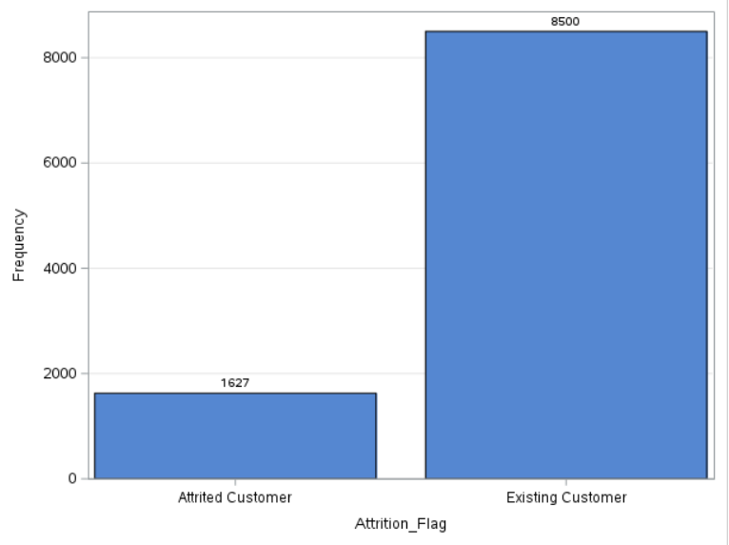
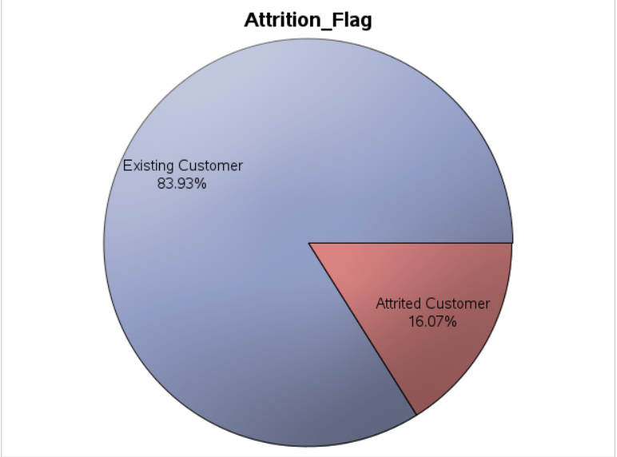
Exploratory Data Analysis
Attrition_Flag (Target/Dependent Variable) : Pie Chart and Bar Chart
Below figures are Pie Chart and Bar Chart of Attrition_Flag (from SAS tool)
The general attrition rate is 16.07% so our aim is to find values that are higher than that in the sub groups of our categorical variables.
Fig.1 Pie Chart (SAS)
Fig.2 Bar Chart (SAS)

Slide 10
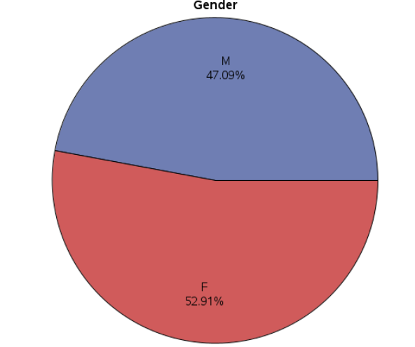
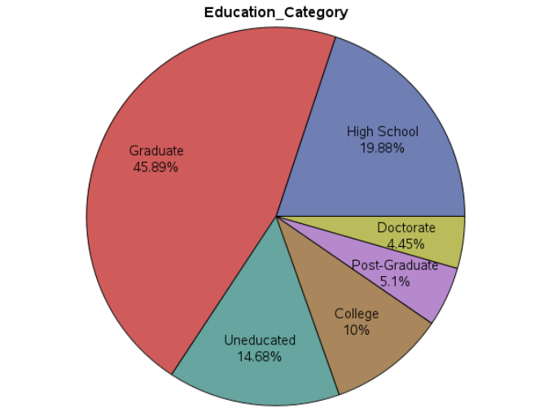
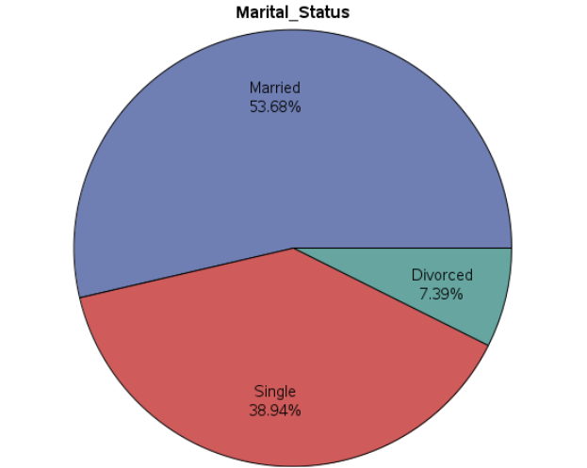
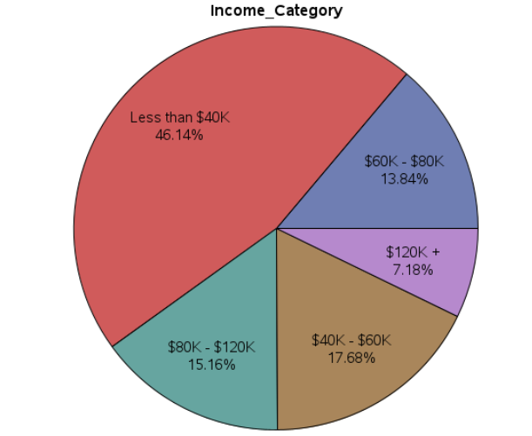
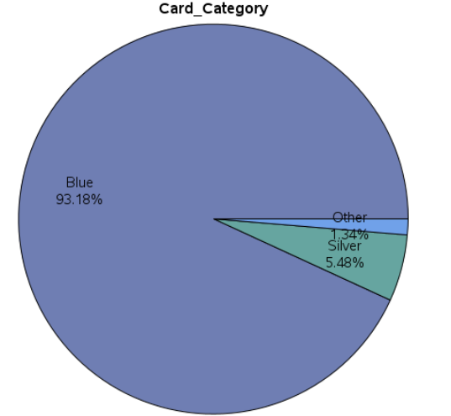
(Features/Independent Variable) : Pie Chart
Attrition rate is 16.07%
Gender - most of the clients (52.9%) are Females.
Education_Level - most of the clients (45.89%) are Graduates.
Marital_Status - most of the clients (53.68%) are Married.
Inocome_Category - most of the clients (46.14%) Have an annual income of less than $40K.
Card_Category - most of the clients (93.18%) Have a Blue credit card.
Fig.1 Pie Charts (SAS)

Slide 11
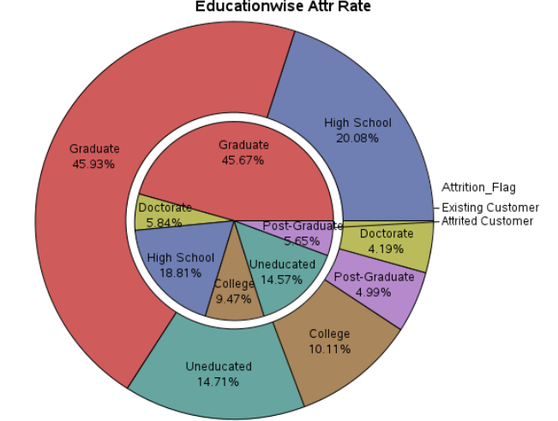
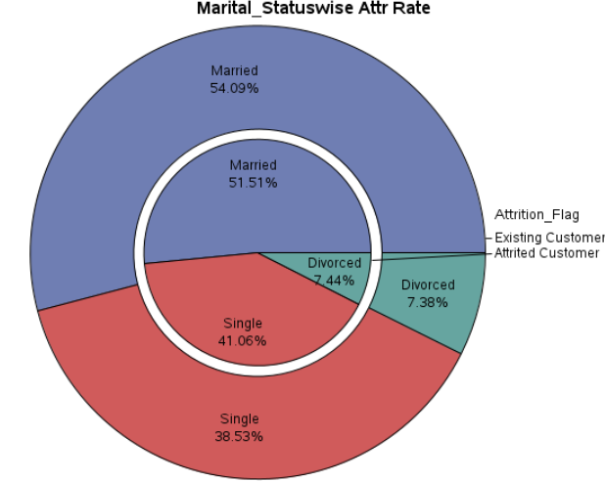
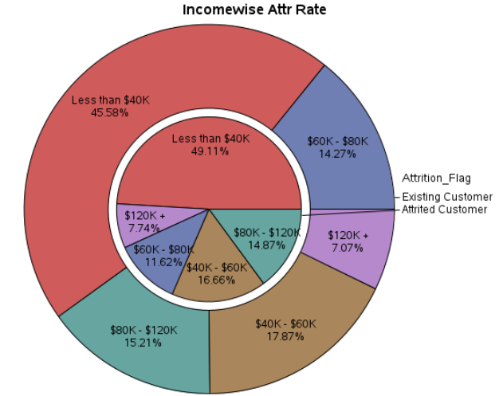
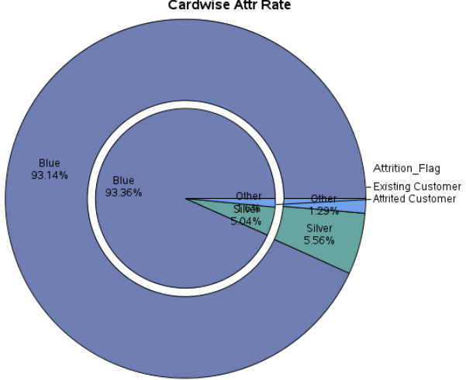
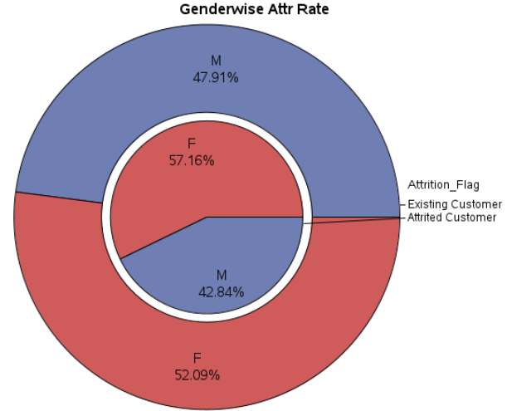
Exploratory Data Analysis
The below conclusions are on 16.1% attrition rate.
Gender - Female clients have a slightly higher (57.16%) Attrition rate.
Education_Level - Graduate clients have a slightly higher (45.67%) Attrition rate
Marital_Status – Married Clients have a slightly higher (51.5%) Attrition rate.
Income_Category - Clients with less than 40000 dollar income have a slightly higher (49.11%) Attrition rate.
Card_Category - Blue and silver card clients have a slightly higher (98.4%) Attrition rate than the gold and platinum.
Fig.3 EDA (Jupyter Notebook)

Slide 12
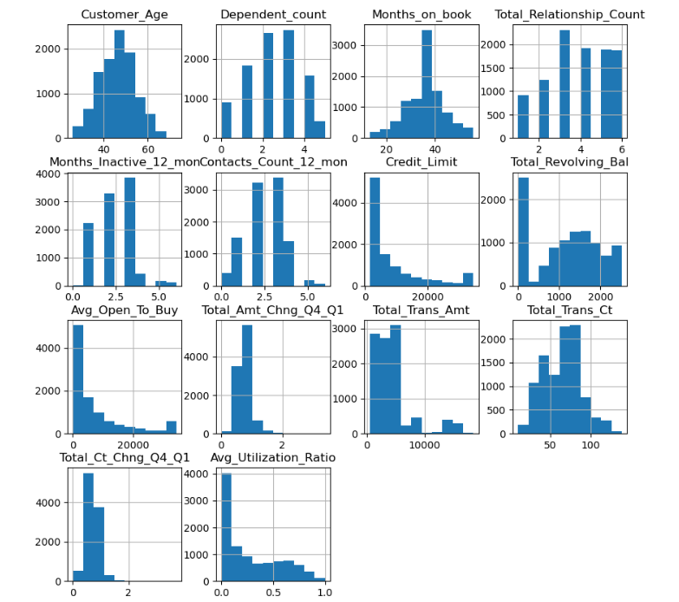
Exploratory Data Analysis
(Features/Independent Variable) : Hist graph
Customer age in our dataset follows a fairly normal distribution
The distribution of Dependent counts is fairly normally distributed with a slight right skew.
We have a very flat shaped distribution in month_on_book (as shown in the plots above as well), meaning we cannot assume normality of the feature.
The distribution of the total_relationship_count ie. total number of products held by the customer seems closer to a uniform distribution.
Credit Limit & Avg_Open_to_Buy are highly correlated hence we can drop these two columns to avoid multicollinearity issue
Distribution of continuous data : Jupyter Notebook

Slide 13
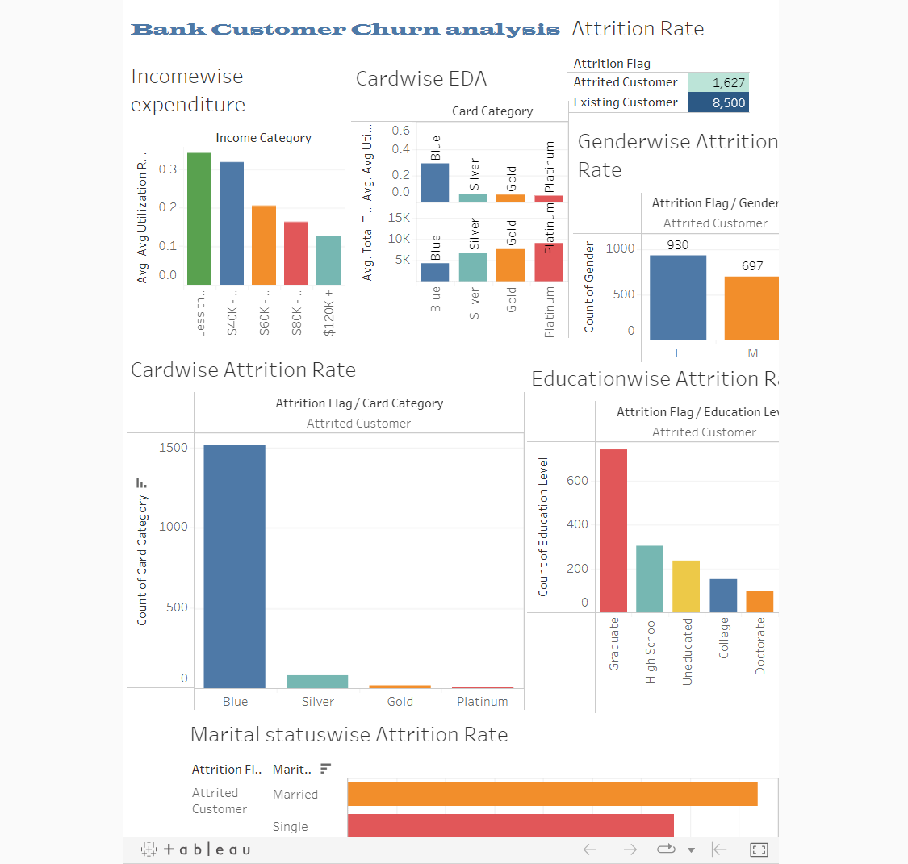
https://public.tableau.com/app/profile/kiran.phondake/viz/CapstoneProject-BankCustomerChurnAnalysis/BankCustomerChurnAnalysis?publish=yes
Bank Churn Analysis : Tableau Dashboard

Slide 14
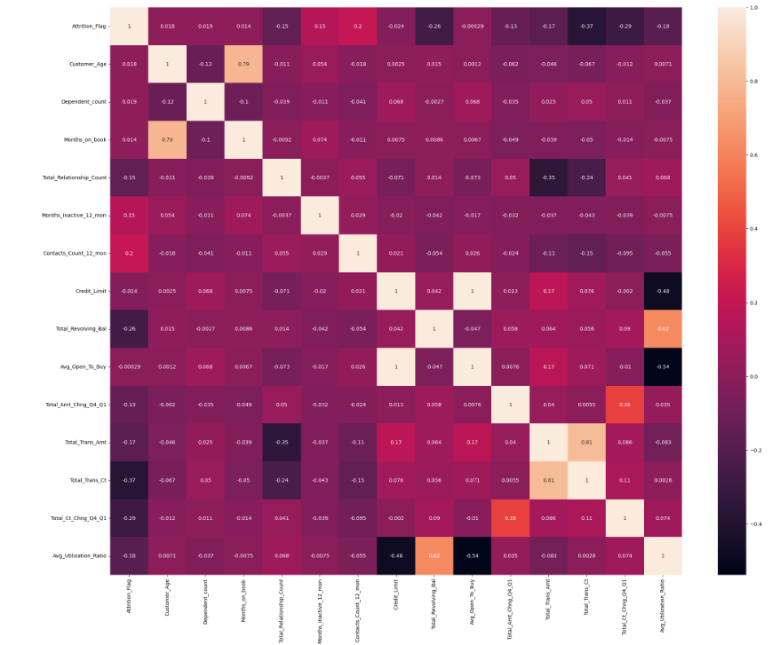
Feature Selection
Feature Selection is the method of reducing the input variable to your model by using only relevant data and getting rid of noise in data.
From Heatmap we observed 'Avg_open_to_buy' and 'Credit_Limit' are highly correlated. Hence, we can drop highly correlated columns to avoid multicollinearity or overfitting issue
Heatmap : Jupyter Notebook

Slide 15
Predictive Analysis
As we have binary classification target data hence we can use supervised learning classifier models for predictive analysis.
1. Logistic Regression 2. KNN ( k-nearest neighbors)
3. Support Vector Machine Algorithm 4. Naïve Bayes Classifier Algorithm
5. Decision Tree Classification Algorithm 6. Random Forest Algorithm
In Previous research papers Naïve Bayes was used for predictive analysis so, in this project Logistic Regression, KNN & Random Forest Algorithm used.

Slide 16
Classification Report
Precision: Precision is a measure of how many positive predictions made are correct or actual Positive
= TP/(TP+FP)
Recall: Recall is a measure of how many of the positive cases the classifier correctly predicted, over all the positive cases.
= TP/(TP+FN)
Accuracy: Accuracy is one metric for evaluating classification models. It defined the no. of correct prediction over total no. of predictions.
= (TP+TN)/(TP+TN+FP+FN)
F1 Score: F1-Score is a measure combining both precision and recall. It is generally described as the harmonic mean of the two.
= (2 * Precision * Recall) / (Precision + Recall)
Confusion Matrix | Pred. -ve | Pred. +ve
Actual –ve | TN | FP
Actual +ve | FN | TP

Slide 17
Accuracy
For prediction the best suited model for this dataset is Random Forest as we got 96% accuracy and from the cross validation score we observed that we can achieve up to 98.00% accuracy.
Classifier | Accuracy
Logistic Regression | 90.27%
KNN | 88.00%
Random Forest | 95.80% ~96.00%

Slide 18
Future Scope
As we saw, only 16% of the data samples represent churn customers; so, for future scope we can use Synthetic Minority Oversampling Technique (SMOTE) to upsample the churn samples to match them with the existing customer sample size to give the predictive models a better chance of catching on small details which will almost definitely be missed out with such a size difference.

Slide 19
Thank You

